Slide 1


Slide 2
TOPIC
BRI (Belt and Road Initiative)&
CPEC(China Pakistan Economic Corridor)

Slide 3
Introduction of BRI
BRI stands for (Belt and Road initiative).
Formation in 2013.
Old name was OBOR(One Belt One Road).
Main Project of china.
Connection with other countries through land and sea.
Connected with three continents ( Asia ,Europe and Africa).

Slide 4
Sub Projects of BRI
There are main six sub projects.
CPEC(China and Pakistan Economic Corridor)
NELBEC(New Eurasian land Bridge Economic Corridor)
CMREC(China Mongolia Economic Corridor)
CCWAEC(China Central and west Asia Economic Corridor).
CIPEC(China Indonesia Peninsula Economic Corridor).
BCMEC(Bangladesh, China and Mynmar Economic Corridor).

Slide 5
Goals of BRI
Grand strategy for their revival.
Project will complete in 2049.
Making relation with other countries .
Connectivity with entire world .
Development of economic.
Cheap things.

Slide 6
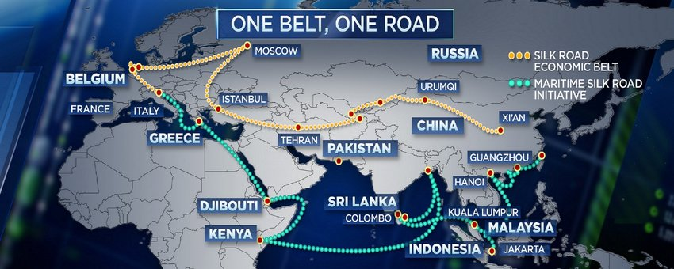

Slide 7
Introduction of CPEC
One the main project of BRI as compare to others .
Start in 2015 (Era of Mian M. Nawaz Sharif)
Distance: 3218 km ( Kashghar to Gwadar).
Investment : $50billion .
Location :Across Pakistan :4 province (KPK ,Punjab , Sindh and Baluchistan).

Slide 8
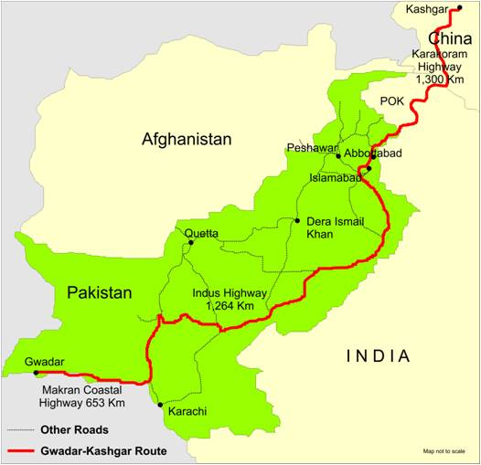

Slide 9
Phases of CPEC
There are two main phases of CPEC.
Energy ,rail roads etc (90% completed)
SEZ(Special Economic Zone).
Total SEZ are nine . Among nine three main
(1)Rashkai KPK. (2) Dhabeji Sindh (3) Allama Iqbal industrial city Punjab
FDI (Foreign direct investment).
Bangladesh has 8 SEZ.

Slide 10
Goals of CPEC
Poverty alleviation.
Agriculture development . Pakistan is an agricultural country.
Industrialization development.
Import and Export.
For Pakistan (Game change).

Slide 11
Benefits of CPEC for China
Low cost route : 16000Km vs 5000Km
Take oil from Saudi Arabia .
Pacific Ocean vs Indian Ocean
Development of Kashghar area.
Fast economic development.
Control on indian Ocean.

Slide 13
Challenges for CPEC
Political instability of Pakistan.
USA Pressure (IMF)
USA and India full try to fail the project of CPEC.

Slide 14


